Slide 1

Green Pace
Security Policy Presentation
Developer: Kevin Bristow

Slide 2

OVERVIEW: DEFENSE IN DEPTH
The security policy and how it supports the defense-in-depth best practice

Slide 3
THREATS MATRIX
Likely STD-002 STD-003 STD-004 STD-005 STD-007 STD-008 STD-009 STD-010 | Priority STD-002 (P6) STD-003 (P18) STD-004 (P18) STD-005 (P8) STD-008 (P12) STD-009 (P6) STD-010 (P18)
Low priority STD-001 (P3) STD-006 (P1) STD-007 (P4) | Unlikely STD-001 STD-006

Slide 4
10 PRINCIPLES
Validate Input Data – Data Value, String Correctness, SQL Injection, Exceptions
Heed Compiler Warnings – Data Type
Architect and Design for Security Policies – SQL Injection, Exceptions
Keep it simple - Environment
Default Deny – Memory Protection
Adhere to the Principle of Least Privilege - Environment
Sanitize Data Sent to Other Systems – Data Value
Practice Defense in Depth - All the standards
Use Effective Quality Assurance Techniques – Data Value, String Correctness
Adopt a Secure Coding Standard – SQL Injection – Memory Protection, Assertions, Exceptions, Arrays

Slide 5
CODING STANDARDS
The 10 coding standards in order of vulnerabilities (highest to lowest)
STD-003 (String Correctness) – L1
STD-004 (SQL Injection) – L1
STD-008 (Environment) – L1
STD-010 (Memory) – L1
STD-002 (Data Value) – L2
STD-005 (Memory Protection) – L2
STD-009 (Arrays) – L2
STD-001 (Data Type) – L3
STD-006 (Assertions) – L3
STD-007 (Exceptions) – L3

Slide 6
ENCRYPTION POLICIES
3 types of encryption
Encryption at rest – Encrypts and protects stored data
Encryption in flight – Encrypts data being transferred
Encryption in use – Keeps data encrypted while using it

Slide 7
TRIPLE-A POLICIES
Three facets to the Triple-A policy
Authentication – Confirms the identity of the user. It asks, “who are you?” and matches credentials to determine whether the user is valid or not.
Authorization – Determines what a user is allowed to do. Once a user is authenticated, authorization takes over and permits what the user can and cannot do
Accounting – Tracks the resources used by users, session information, and data sent and received. Records all that goes on within the system.

Slide 8
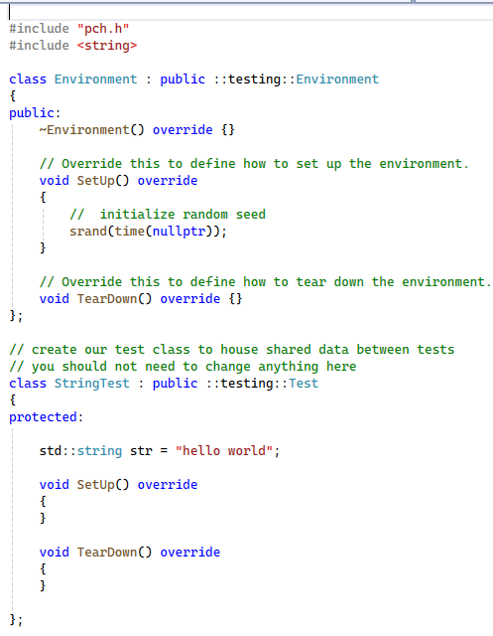
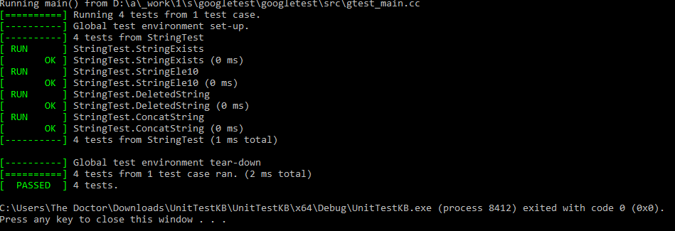
Unit Testing - String Correctness
Unit Testing Starter Code
Testing vulnerabilities with strings

Slide 9
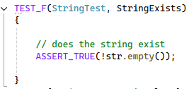
Unit Testing Cont… - Does the String Exist?
Assert true that the string is not empty

Slide 10
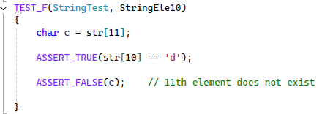
Unit Testing Cont…Accessing Out of Range
Assert 10th element is ‘d’
Assert that the 11th element does not exist

Slide 11
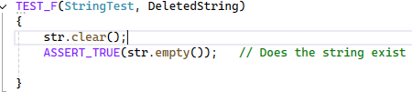
Unit Testing Cont…String is Deleted
Assert string no longer exists after clearing it

Slide 12
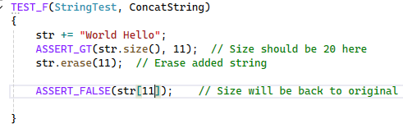
Unit Testing Cont…Deleted Memory Can’t be Accessed
Concatenated two strings
Assert that the deleted portion of the string no longer exists

Slide 13

AUTOMATION SUMMARY

Slide 14
TOOLS
The DevSecOps pipeline is the continuous integration/continuous deployment lifecycle of producing production level software. Security has been added to DevOps in recent times because of the importance of security.
Security tools exist to help in the DevSecOps automated pipeline.
In pre-production: dependency checkers or source code analyzers such as Cppcheck
In production: penetration testing and reporting can be utilized. tools such as LDRA tool suite can be used to automate testing of the code and to provide reports for audits and quality assurance

Slide 15
RISKS AND BENEFITS
The problem is that software is a powerful double-edged sword
Humans are prone to creating bugs
Solution: Static tests, threat modeling, thinking like a hacker, unit testing, penetration testing
Waiting is expensive, breaks trust, and exposes sensitive information to name a few
Proactive solutions are better than waiting as they protect all of the above

Slide 16
RECOMMENDATIONS
Adopt a standard
Think about how a hacker will think (threat modeling)
Build with a security mindset
Educate on social engineering attacks (phishing, pretexting, baiting)

Slide 17
CONCLUSIONS
The 10 standards shown are recommended to be adopted
Incorporate Defense in Depth and Triple-A Framework

